Slide 1






Weather Forecast Using ML Techniques
Project Phase A
Dor Shabat
Yuval Rozner
WeatherNet - GitHub
WeatherNet – Phase A Paper

Slide 2


Presentation Roadmap
Project Overview
Motivation
Progress and Achievements
Proposed Architecture
System Goals
Website Interface
-2-

Slide 3

Project Overview
Project Overview
Motivation
Progress and Achievements
Proposed Architecture
System Goals
Website Interface
-3-

Slide 4



Project Overview
WeatherNet introduces a machine learning-driven approach, broadening the range of techniques available for accurate weather forecasting in Israel.
Innovative weather forecasting system for Israel
ML-based approach using historical and real-time data
Focus on mid-term temperature prediction for 3 regions (north, center, south)
Provides forecasts up to four days in advance
Hybrid architecture combining CNNs, LSTMs, and Attention mechanisms
Accessible through a web-based platform with real-time forecasts & interactive accuracy comparison tools
-4-

Slide 5
Motivation
Project Overview
Motivation
Progress and Achievements
Proposed Architecture
System Goals
Website Interface
-5-

Slide 6



Motivation
Numerical Weather Prediction → Machine Learning
Traditional weather forecasting relies on Numerical Weather Prediction (NWP) models.
NWP models are based on physical laws and statistical methods to simulate atmospheric processes.
Machine-Learning provides an alternative by capturing non-linear patterns and processing large, complex datasets more efficiently.
-6-

Slide 7



Motivation (cont.)
Connection with Israel Meteorological Service (IMS)
Early in the project, we connected with IMS to discuss their forecasting methods.
We gained insights into how they archive their forecasts (NWP-based).
We got access to their data API, allowing us to retrieve real-time and historical weather data.
-7-

Slide 8

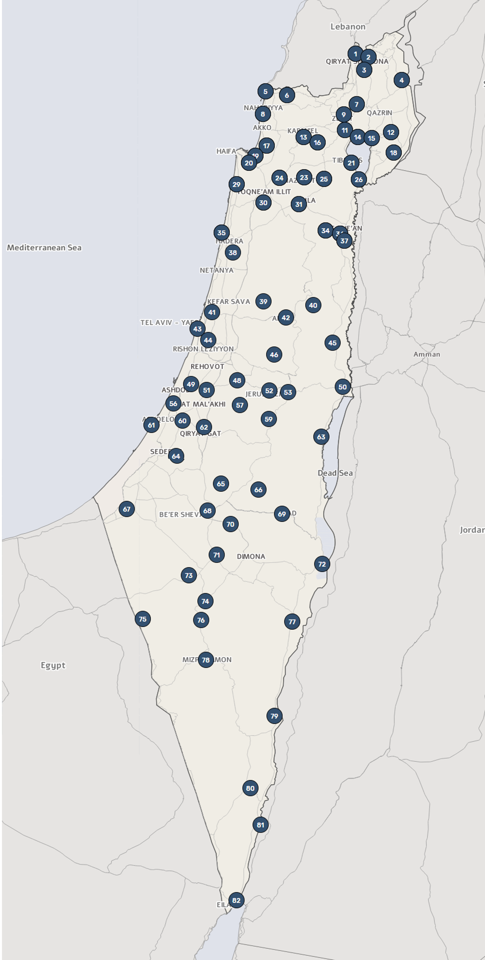
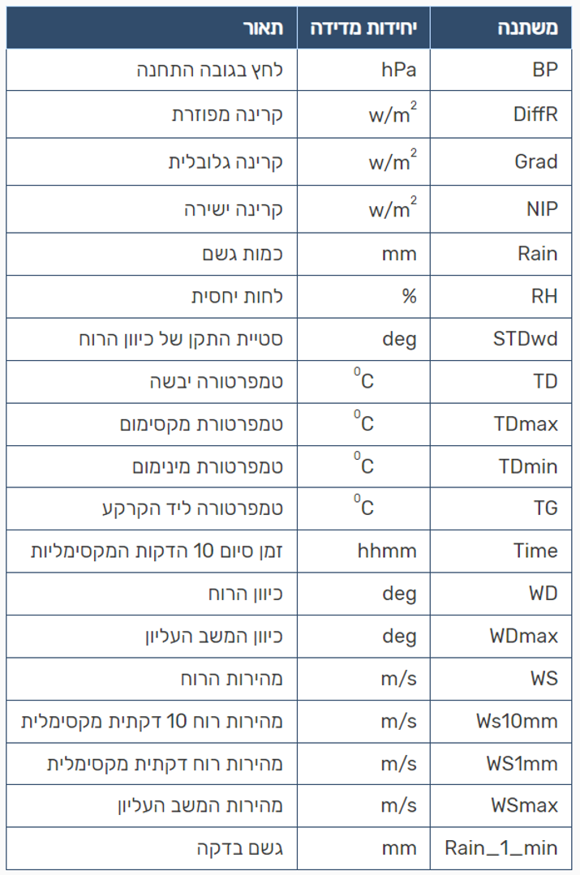
Motivation (cont.)
IMS Stations and Recorded Parameters
IMS operates 82 weather measurement stations across Israel.
They measure key weather parameters, including:
Temperature
Humidity
Wind direction and speed
Radiation
Pressure
Precipitation
-8-

Slide 9
Progress and Achievements
Project Overview
Motivation
Progress and Achievements
Proposed Architecture
System Goals
Website Interface
-9-

Slide 10




Progress and Achievements
key milestones and progress so far
Data access and initial setup for Jerusalem Station (2000-2023)
Data preprocessing techniques
Exploratory data analysis
Early model experiments and Insights gained
-10-

Slide 11

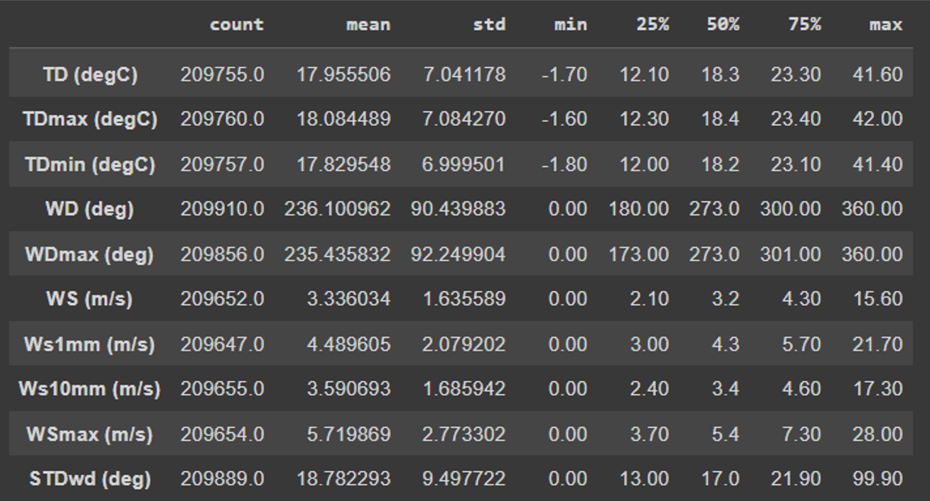

Data Analysis
Analysis of the Jerusalem station data (2000–2023), revealing gaps in the dataset.
To address these gaps, we explored various missing data imputation techniques.
-11-

Slide 12


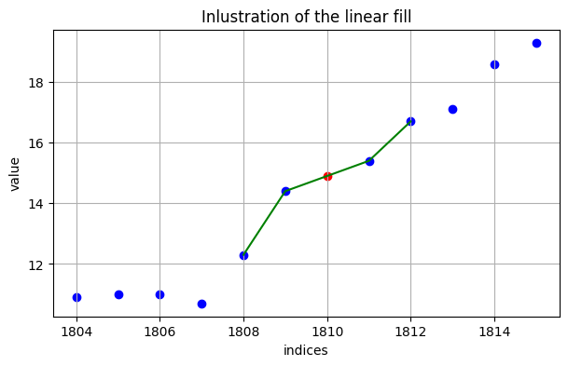

Missing Data Imputation
Demonstration of a simple linear interpolation method to fill missing values in the dataset.
The red point represents the interpolated value, calculated as the average of its neighboring points.
-12-

Slide 13


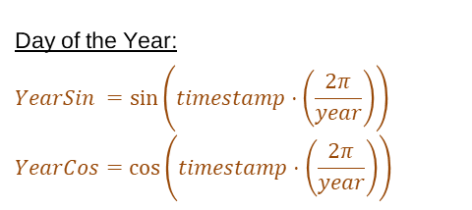
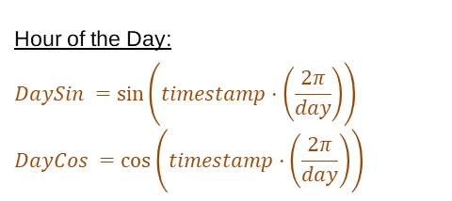
Cyclic Parameters - Time
In Weather Data, Time behaves as a cyclic parameter.
For instance, 06:00 on any given day should be treated similarly across all days, rather than as a continuous, linear progression.
Likewise, the day of the year follows a cyclical pattern, where the same date in different years (e.g., seasonal changes) is treated similarly.
To represent time as a cyclic parameter, we apply sin and cos transformations, converting time into cyclical values that the model can interpret.
Hour of the Day:
$$DaySin =\sin\left(timestamp⋅\left(\frac{2π}{day}\right)\right)$$
$$DayCos =\cos\left(timestamp⋅\left(\frac{2π}{day}\right)\right)$$
Day of the Year:
$$YearSin =\sin\left(timestamp⋅\left(\frac{2π}{year}\right)\right)$$
$$YearCos=\cos\left(timestamp⋅\left(\frac{2π}{year}\right)\right)$$
-13-

Slide 14
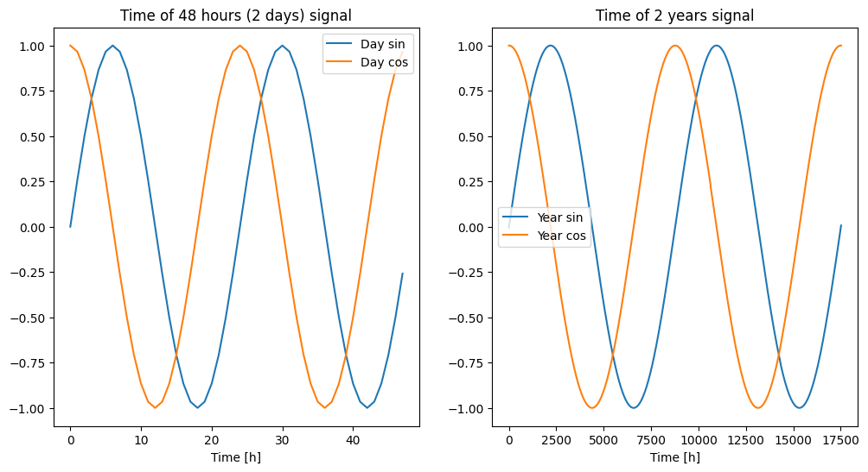
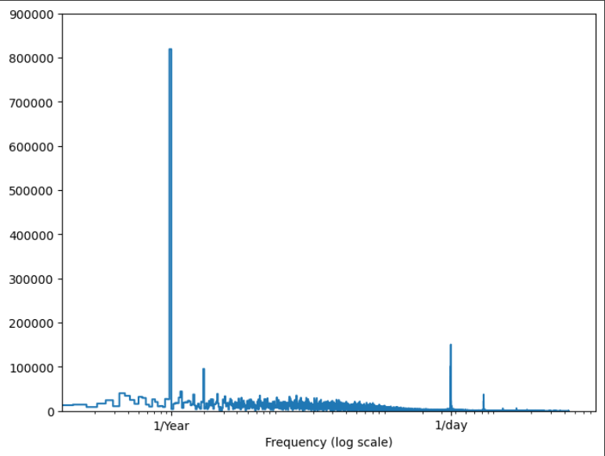
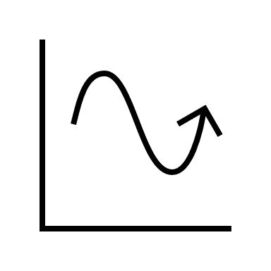

Cyclic Parameters - Time
-14

Slide 15


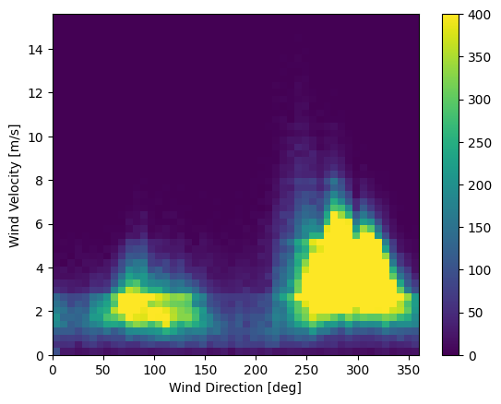
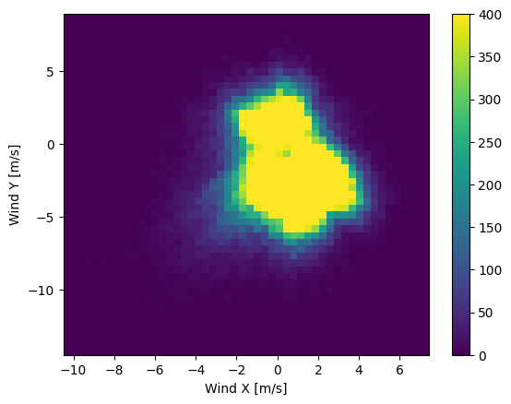

Cyclic Parameters - Wind
Wind direction and speed are recorded as separate parameters.
The problem is: 0° and 359° are very close in terms of wind direction - but in a linear model, they appear far from each other.
To model wind parameters effectively, we convert them into vectors, allowing the model to treat wind as a cyclic parameter.
-15-

Slide 16
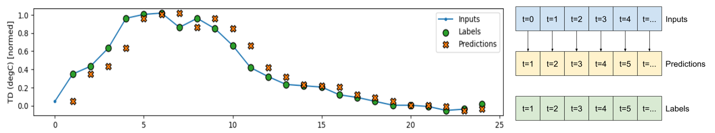

Early Implementations of simple ML Models
We trained a variety of simple models to evaluate their capabilities and potential for weather forecasting.
Each model was designed to predict temperature one hour ahead, continuously for a 24-hour forecasting window.
Baseline model: Assumed that the next hour would be the same as the current.
-16-

Slide 17
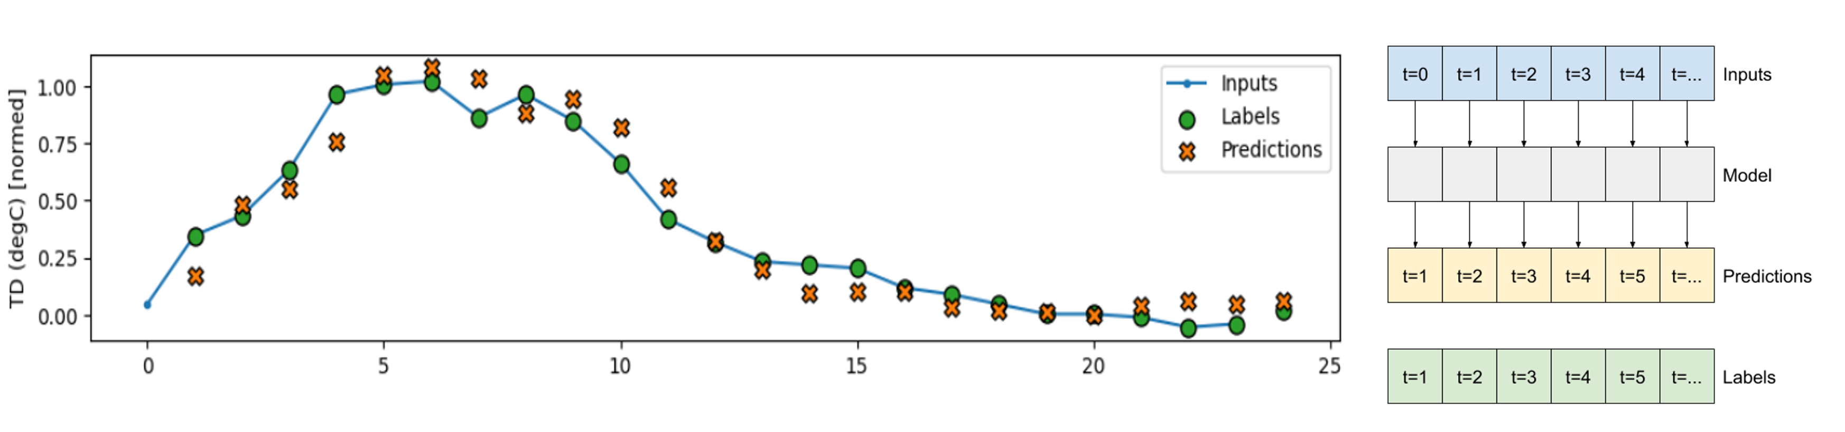
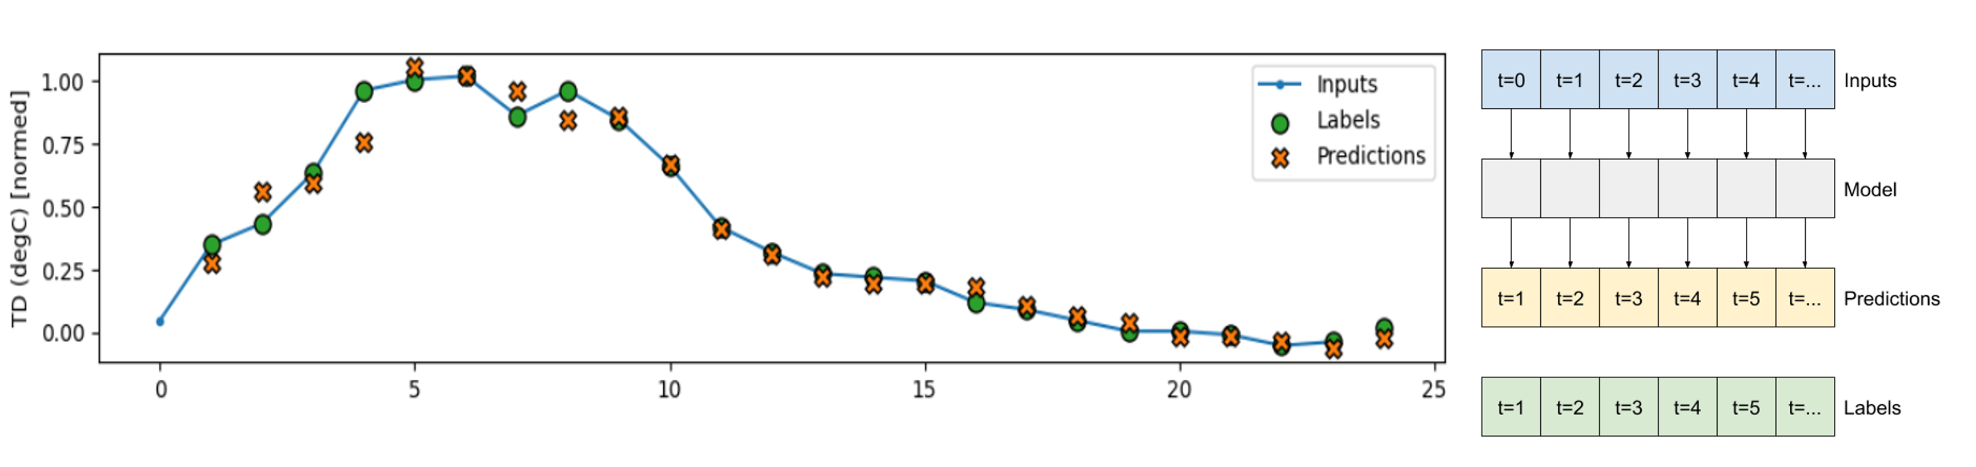
Linear Model:
Dense Model:
-17-

Slide 18
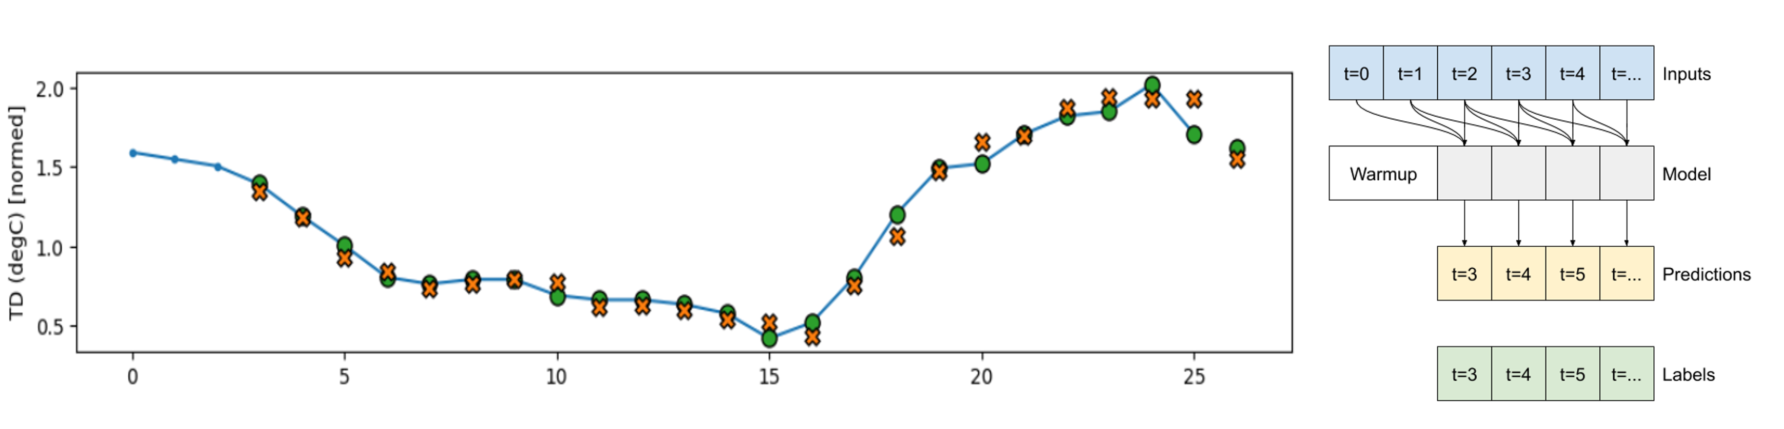
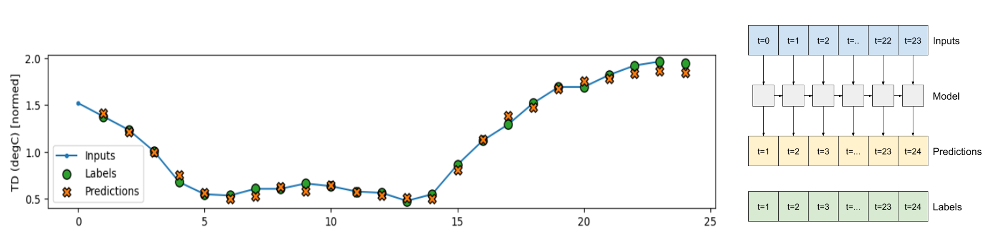
CNNs Model:
RNNs Model:
-18-

Slide 19
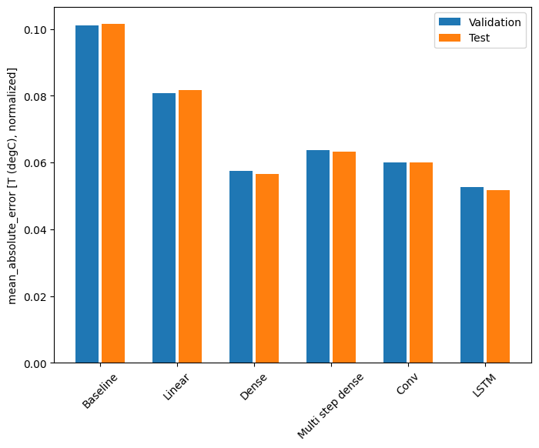
Performance:
With these results in mind, we’ll now dive into our proposed architecture designed to improve forecasting accuracy …
-19-

Slide 20
Proposed Architecture
Project Overview
Motivation
Progress and Achievements
Proposed Architecture
System Goals
Website Interface
-20-

Slide 21
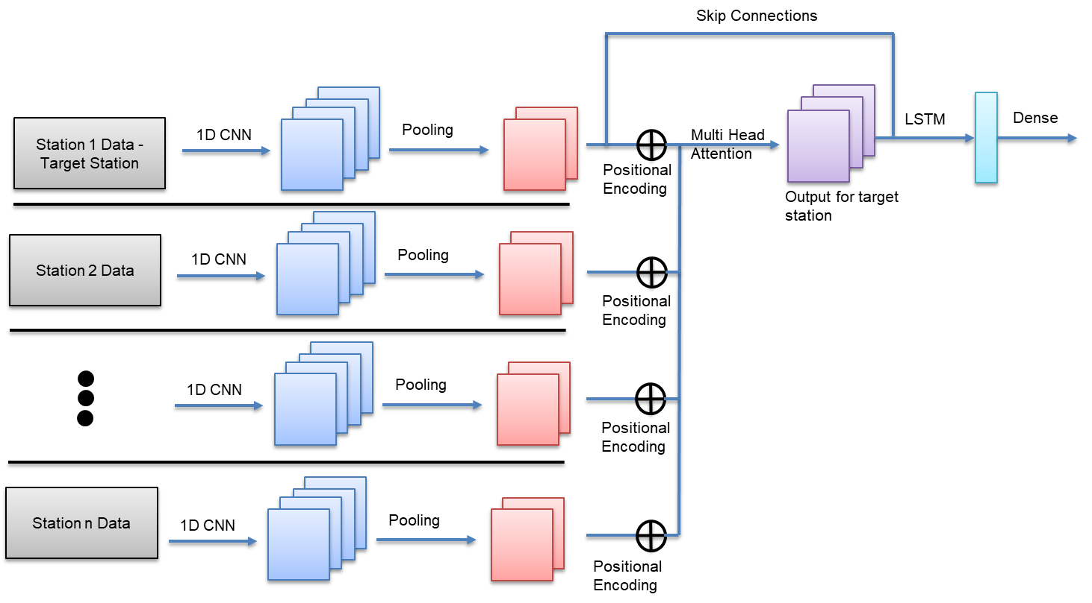
Architecture Overview
CNNs for short-term pattern detection
LSTMs for long-term dependencies
Attention Mechanism for spatial relationships between stations
-21-

Slide 22
Gather and Process Weather Station Data
Data Collection: Collect historical weather data (temperature, wind, humidity, etc.) from multiple stations.
Preprocessing: Clean, normalize, and handle missing data.
Cyclic Encoding: Transform time-based features to capture daily and seasonal weather cycles.
Processing Data
Station 82 Data
Station n Data
Station 81 Data
Station 80 Data
Station 79 Data
Station 2 Data
Station 1 Data -
Target Station
-22-

Slide 23
Independent Path for Each Weather Station
Process each weather station’s data independently.
Understand different patterns or details on each station.
1D CNN
Station n Data
1D CNN
1D CNN
Station 2 Data
Station 1 Data -
Target Station
1D CNN
-23-

Slide 24
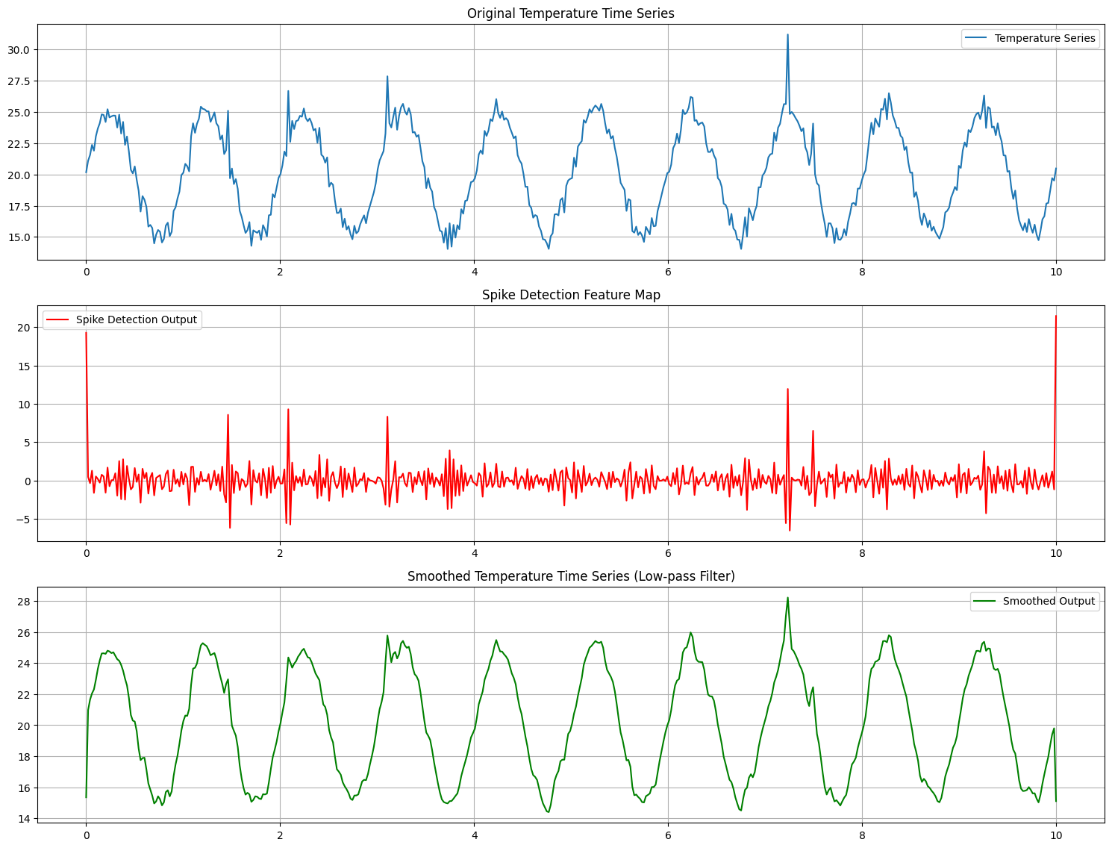
1D CNN
Process each weather feature independently, across the time dimension.
Capture short-term patterns.
1D CNN – use multiple filters, output multiple feature maps
Input – Temperature data over 10 days
Outputs – Feature maps
Station i Data -
Target Station
1D CNN
-24-

Slide 25
Pooling
Reduce the dimensionality of the output.
This process helps to retain the most important features while discarding unnecessary details.
Station 1 Data -
Target Station
Pooling
1D CNN
Station 2 Data
Pooling
1D CNN
1D CNN
Pooling
Station n Data
Pooling
1D CNN
-25-

Slide 26
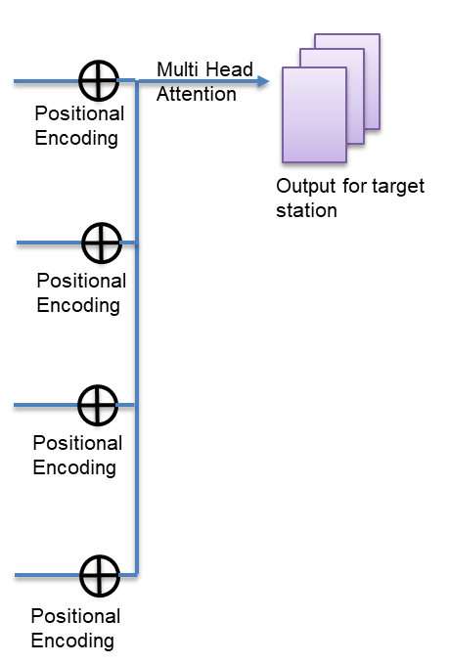
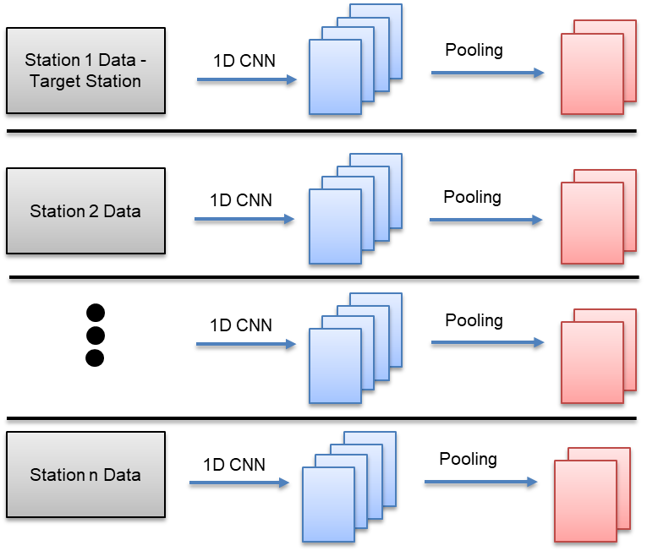
Attention and Positional Encoding
Positional Encoding:
Introduces geographical location (latitude and longitude) into the model using latitude and longitude.
Attention Mechanism:
helps the model learn how stations influence the target station.
This allows the model to focus on the most relevant station data for each forecast, enhancing the accuracy of predictions by considering cross-station relationships.
-26-

Slide 27
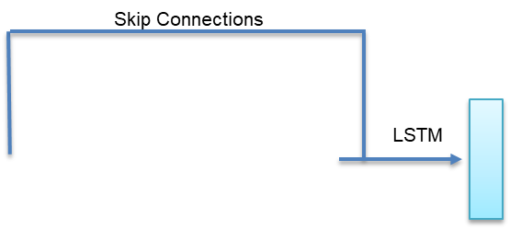
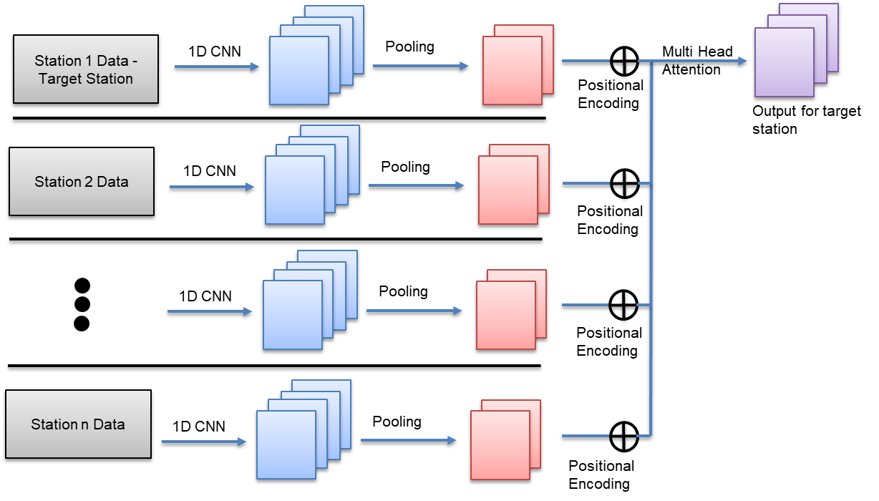
LSTM and Skip Connection
Long Short-Term Memory (LSTM):
capture long-term temporal dependencies.
Skip Connection:
This ensures that both short-term fluctuations and spatial dependencies between different stations accounted for in the LSTM.
-27-

Slide 28
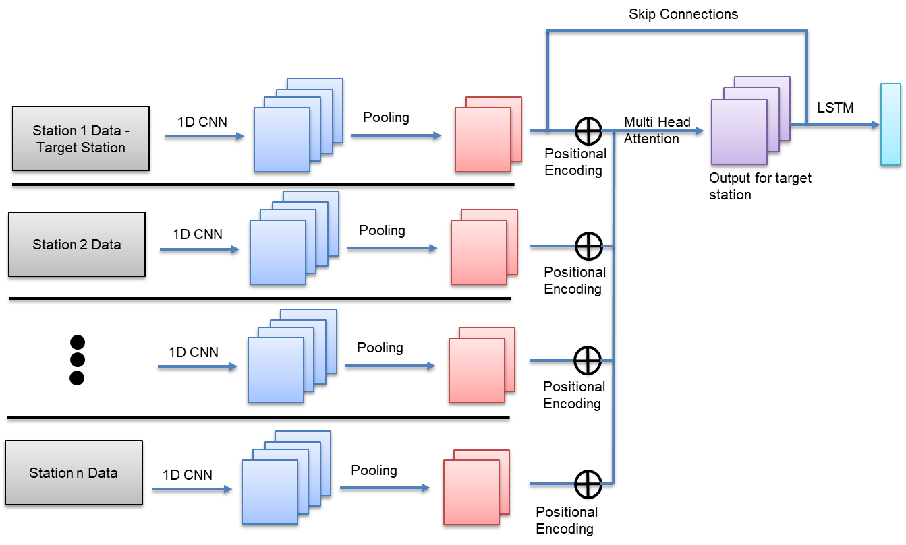
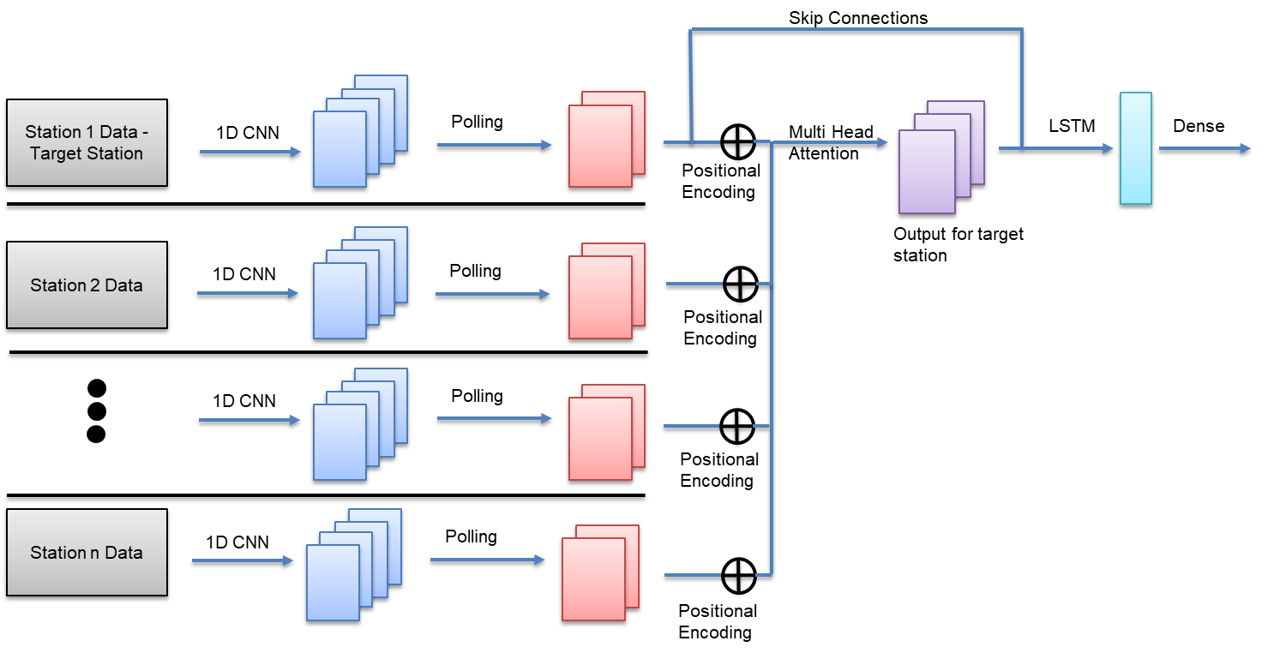
Dense Layer for Final Prediction
Fully Connected Dense Layer:
The dense layer combines all the extracted features (from CNN, attention, and LSTM) to make the final weather prediction.
Prediction Output:
This layer outputs the forecast for the target station.
The dense layer helps to refine and integrate all learned patterns into a prediction.
-28-

Slide 29
Key Contributions of Each Model Component
spatial dependencies between different stations - understand how weather at one station affects Target Station
weather data from multiple stations after preprocessing.
most important patterns in each feature
short-term patterns for each feature
long-term trends over the window size
Combines all the learned patterns to produce the final weather forecast for the target station.
Introduces geographical location (latitude and longitude) into the model
-29-

Slide 30
Key Hyperparameters for Model Optimization
Learning Rate: Controls how much the model’s weights are updated during training.
Batch Size: Determines the number of samples processed before updating model weights.
Number of Filters (CNN): Controls how many patterns the model will learn.
Kernel Size (CNN): Defines the width of the convolution window across the time dimension.
Hidden Units (LSTM): Affects the model’s ability to capture long-term dependencies.
Attention Heads: Controls how many independent layers learn spatial dependencies.
Time Window Size: Defines the input-output time frames for forecasting (e.g., 24 hours, 48 hours).
Epochs: The number of complete passes through the dataset during training.
-30-

Slide 31
System Goals
Project Overview
Motivation
Progress and Achievements
Proposed Architecture
System Goals
Website Interface
-31-

Slide 32
System Goals
Forecast Precision and Performance Goals
Primary Goal: Predict temperature with high precision.
Focus Regions: North (Haifa), Center (Tel Aviv), South (Beer-Sheva).
Forecast Duration: Reliable hourly temperature predictions for up to four days ahead.
Accuracy Target: Aim for an error margin of less than 1.5°C.
Competitive Benchmark: Comparison with IMS forecasts to match or exceed their accuracy.
-32-

Slide 33
Website Interface
Project Overview
Motivation
Progress and Achievements
Proposed Architecture
System Goals
Website Interface
-33-

Slide 34


UI – WeatherNet Website
Real-Time Forecasts and Accuracy Insights
Real-time weather updates displayed on the website.
Prediction accuracy insights: The website will allow users to track the accuracy of WeatherNet’s forecasts over time.
Interactive comparison tools to compare WeatherNet forecasts with IMS forecasts, providing transparency in accuracy.
-34-

Slide 35

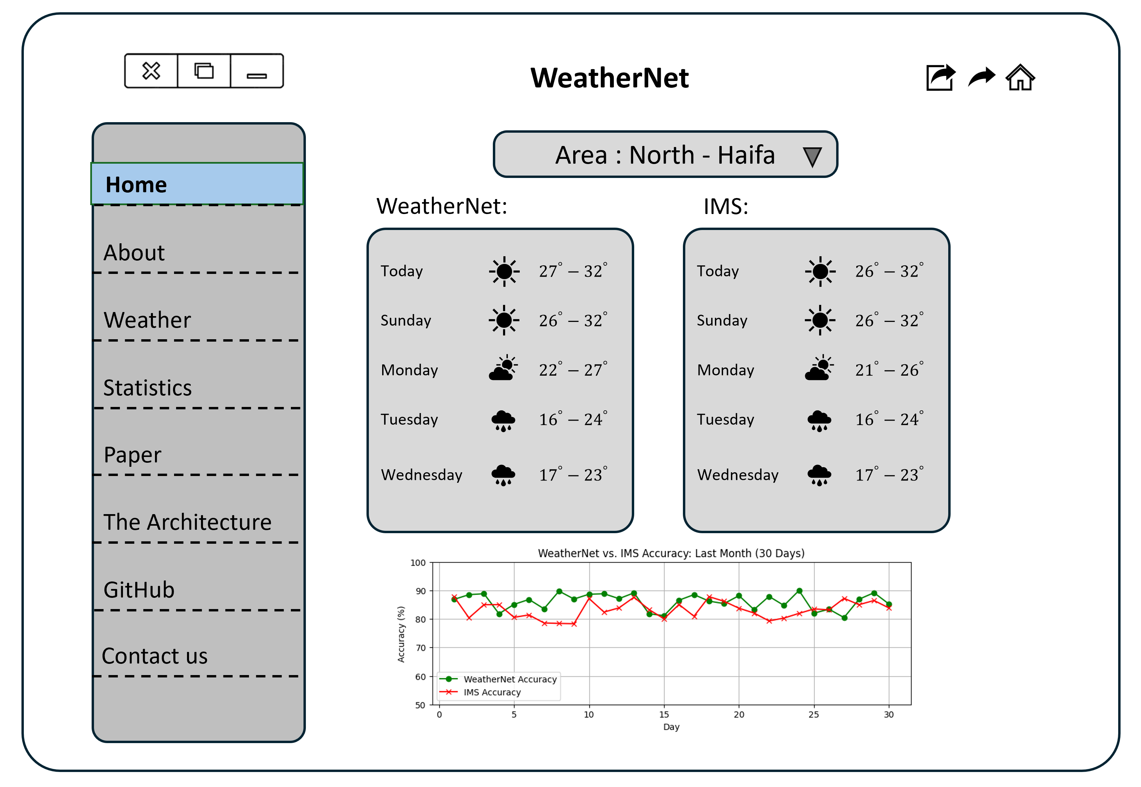
UI – WeatherNet Website
-35-

Slide 36
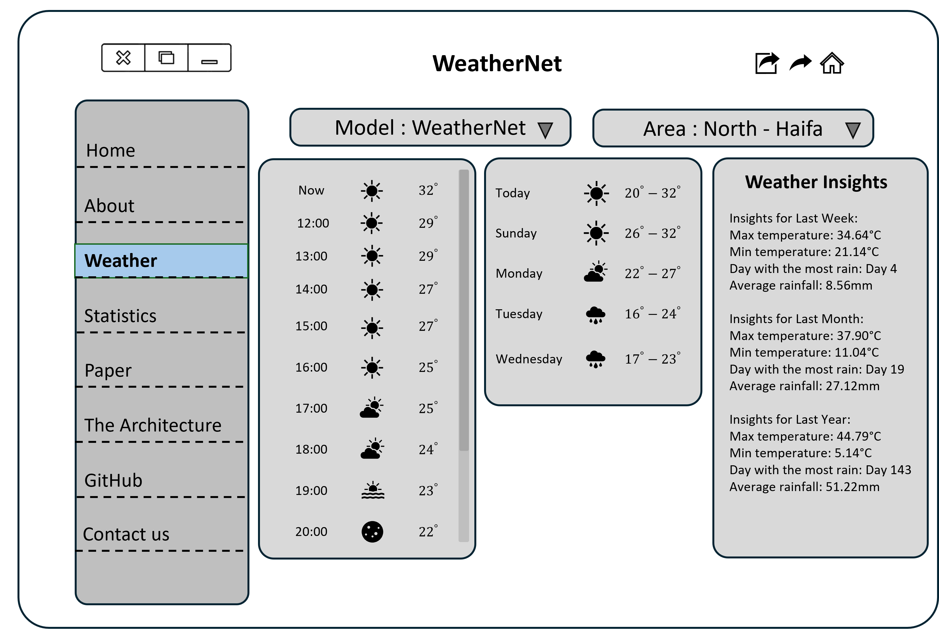
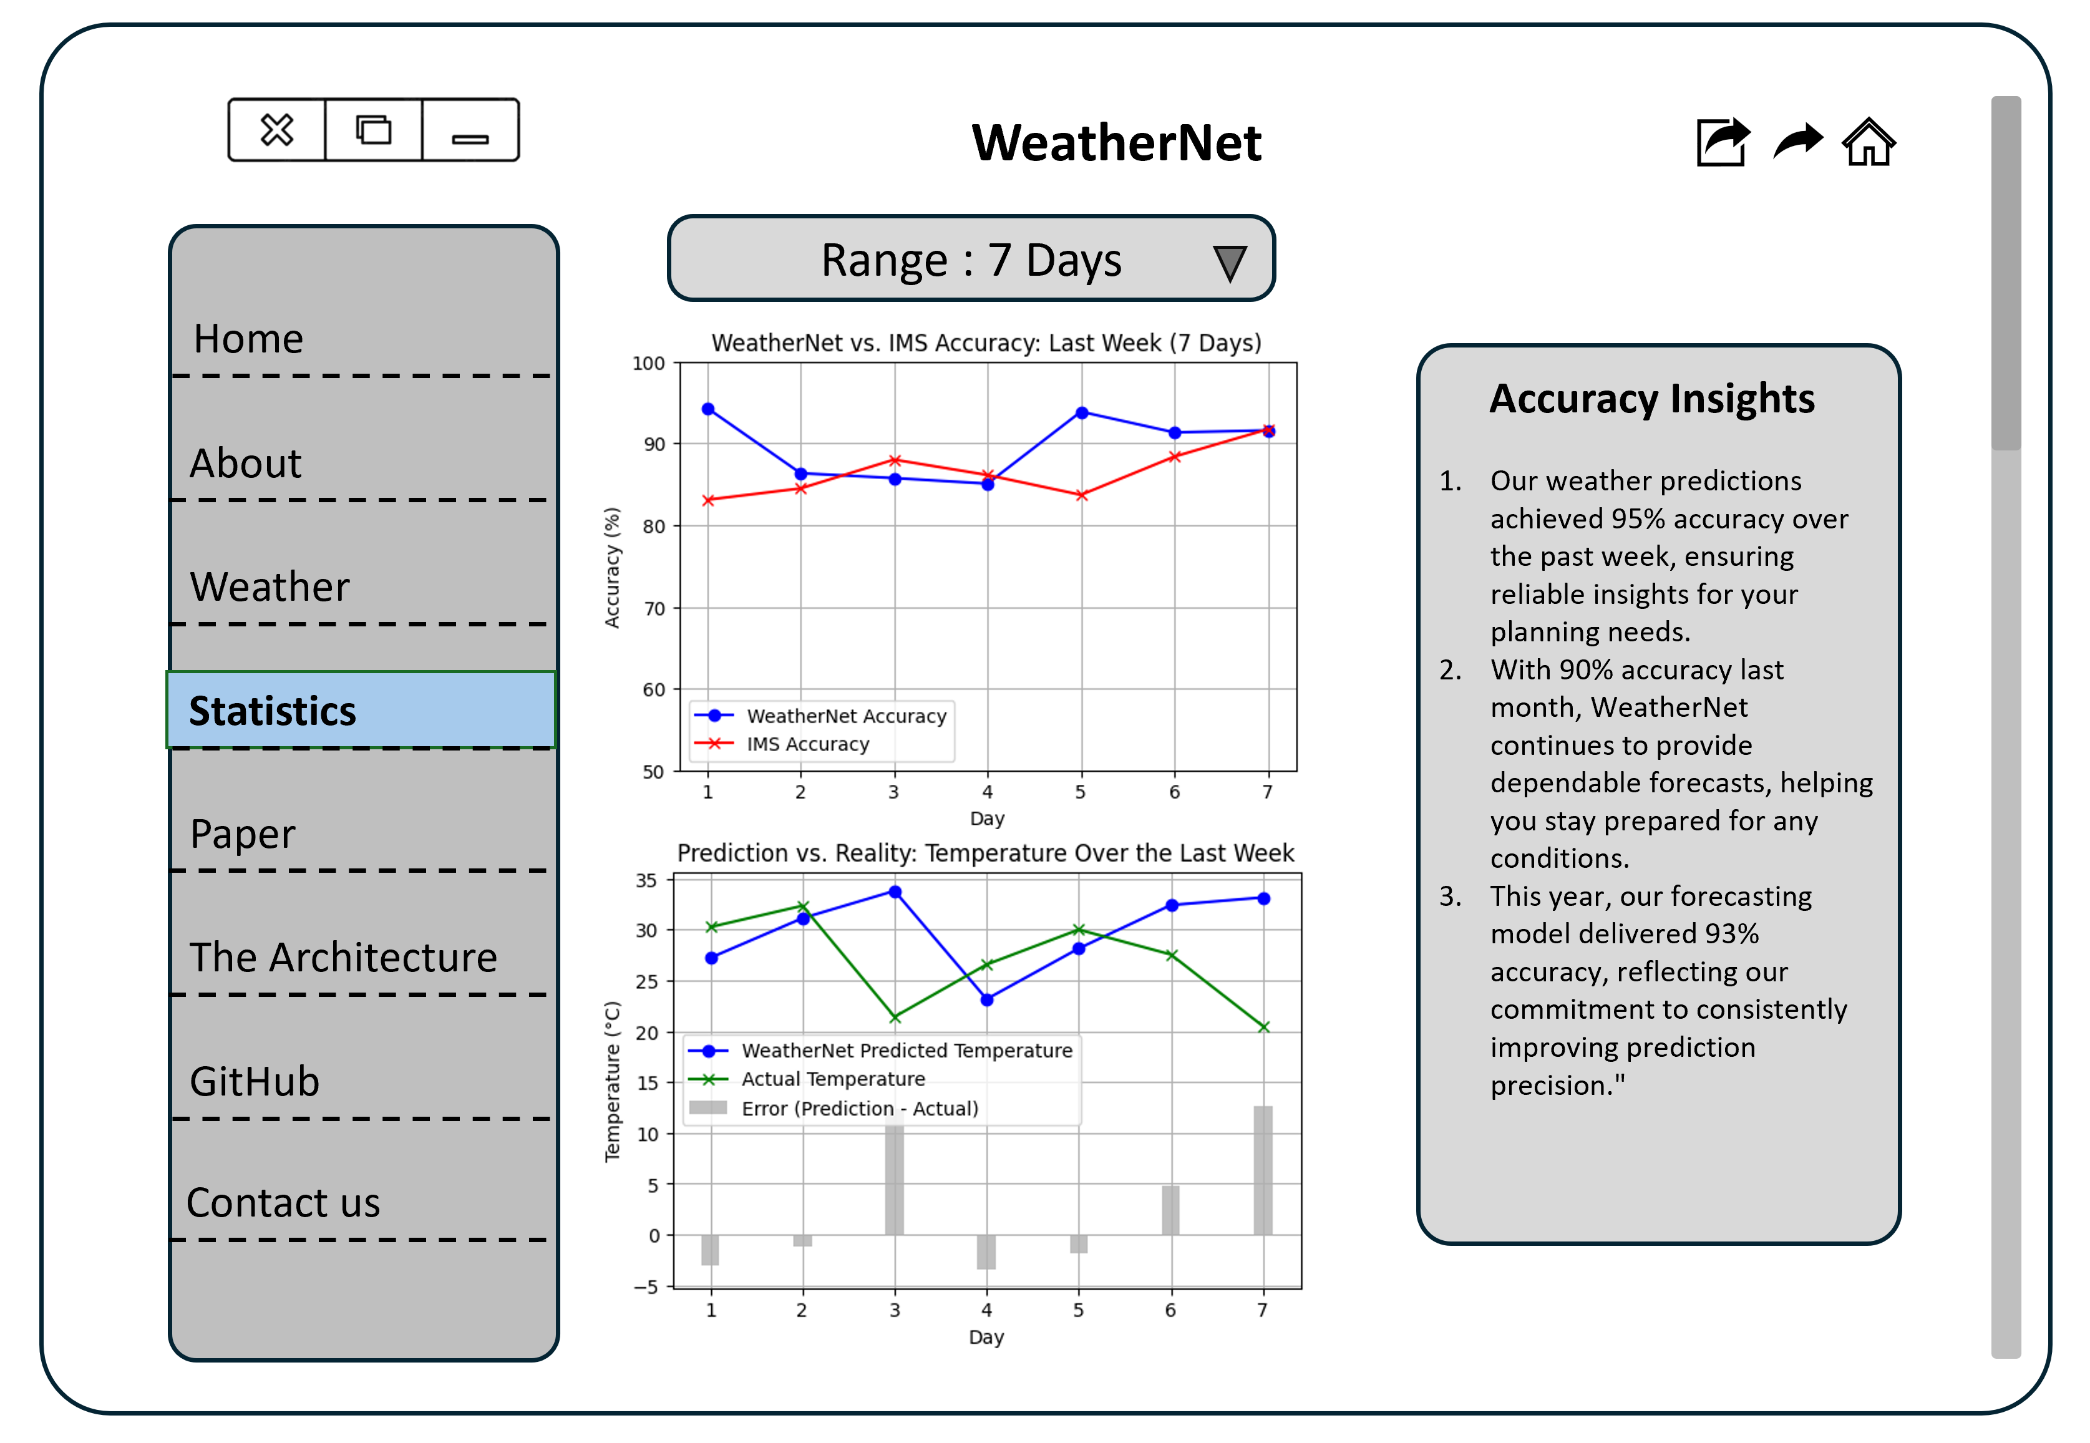
UI – WeatherNet Website
-36-

Slide 37
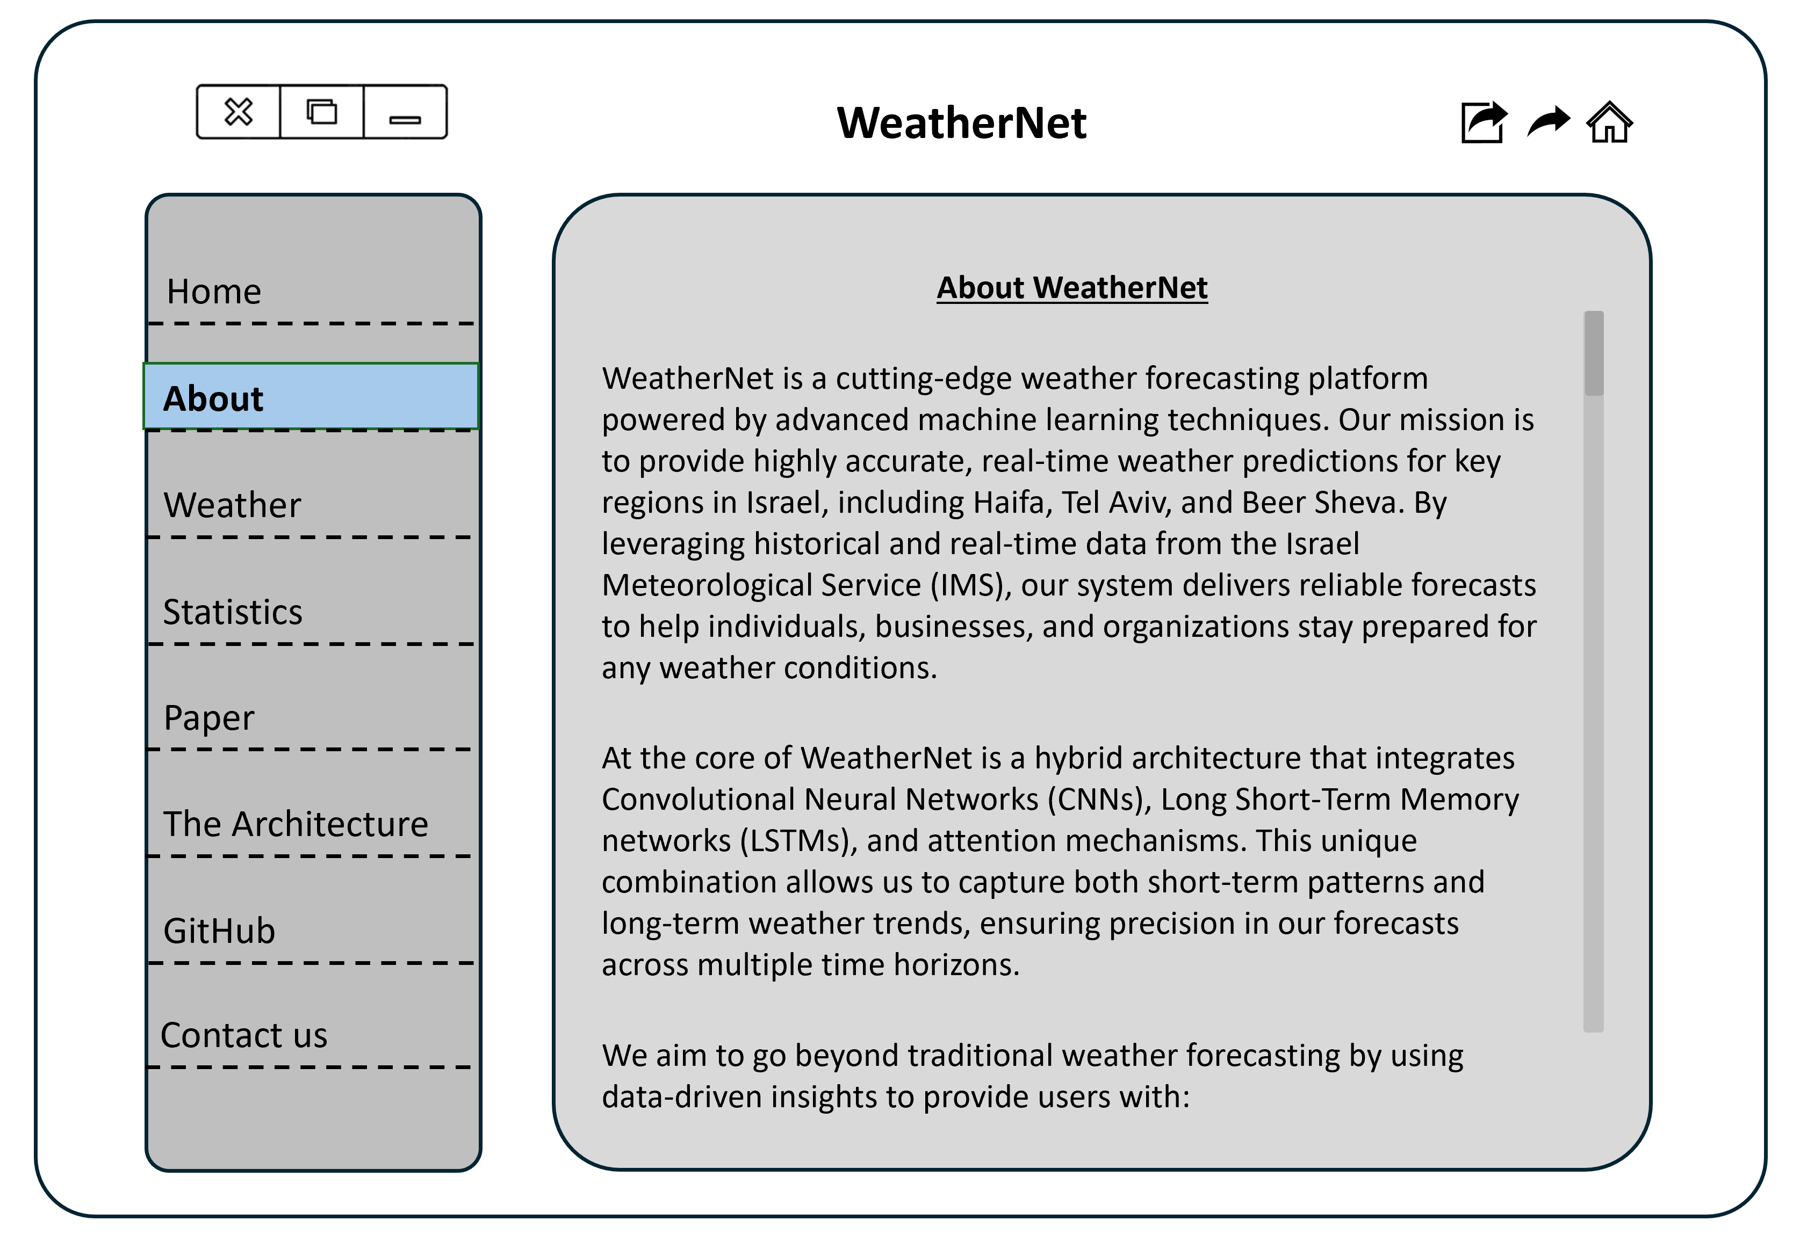
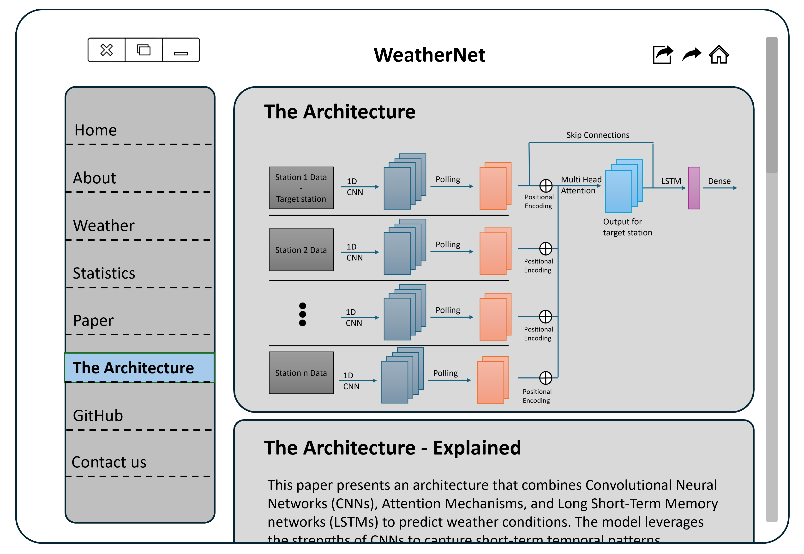
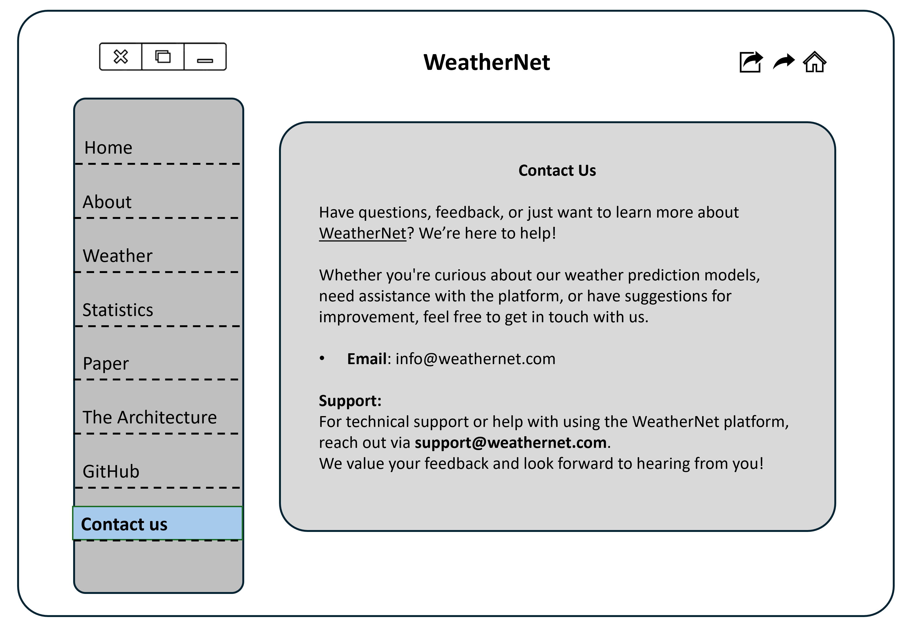

UI – WeatherNet Website
-37-

Slide 38
Thank you!
WeatherNet - where machine learning meets the art of nature.
Dor Shabat
Yuval Rozner
WeatherNet - GitHub
-38-
WeatherNet – Phase A Paper

